Slide 1


Slide 2
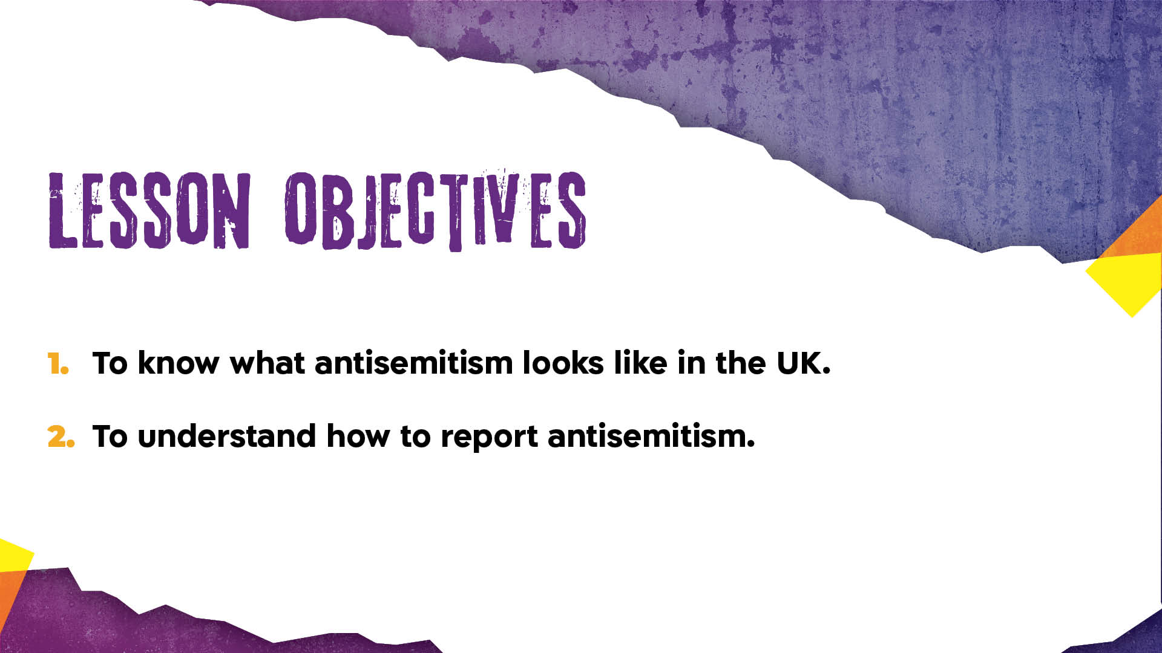

Slide 3
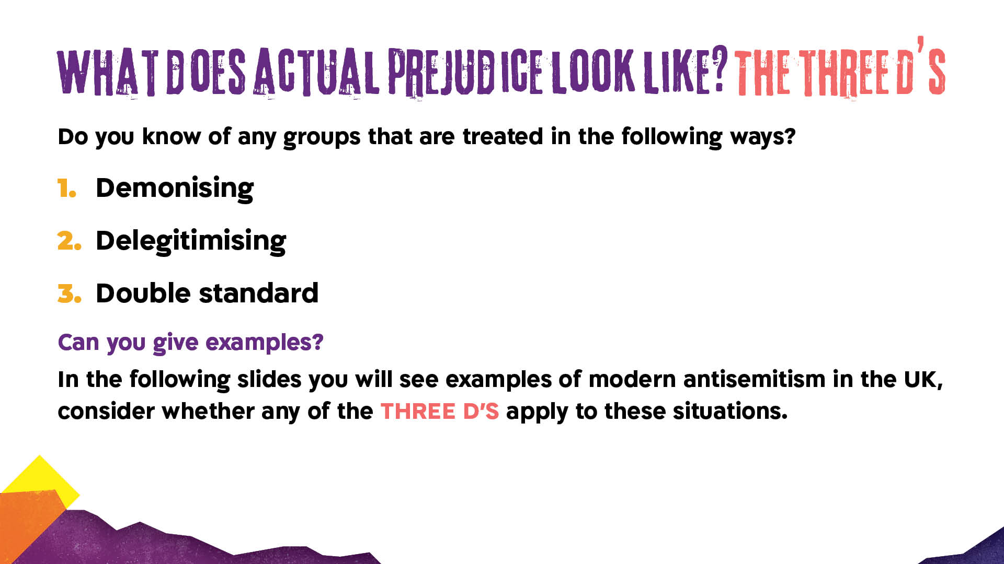
Notes:
Examples of groups experiencing prejudice might include women, for example. E.g. OFTEN in the workplace if a women cries it is considered emotional and weak whereas a man who shows emotion is considered vulnerable and strong. If a woman gets angry in the workplace she is seen as aggressive whereas a man will be considered a strong leader. Women are called “bossy” where men are called “assertive” for the same actions. This is a double standard because it is the same behaviour but a different standard is applied. A woman who gets angry will be considered a shrew, or “hysterical” and this is effectively demonising her and deligitimising her feelings.

Slide 4

Notes:
May 2016 - Manchester
https://www.theguardian.com/uk-news/2016/may/19/jewish-headstones-smashed-cemetery-abhorrent-antisemitic-manchester

Slide 5
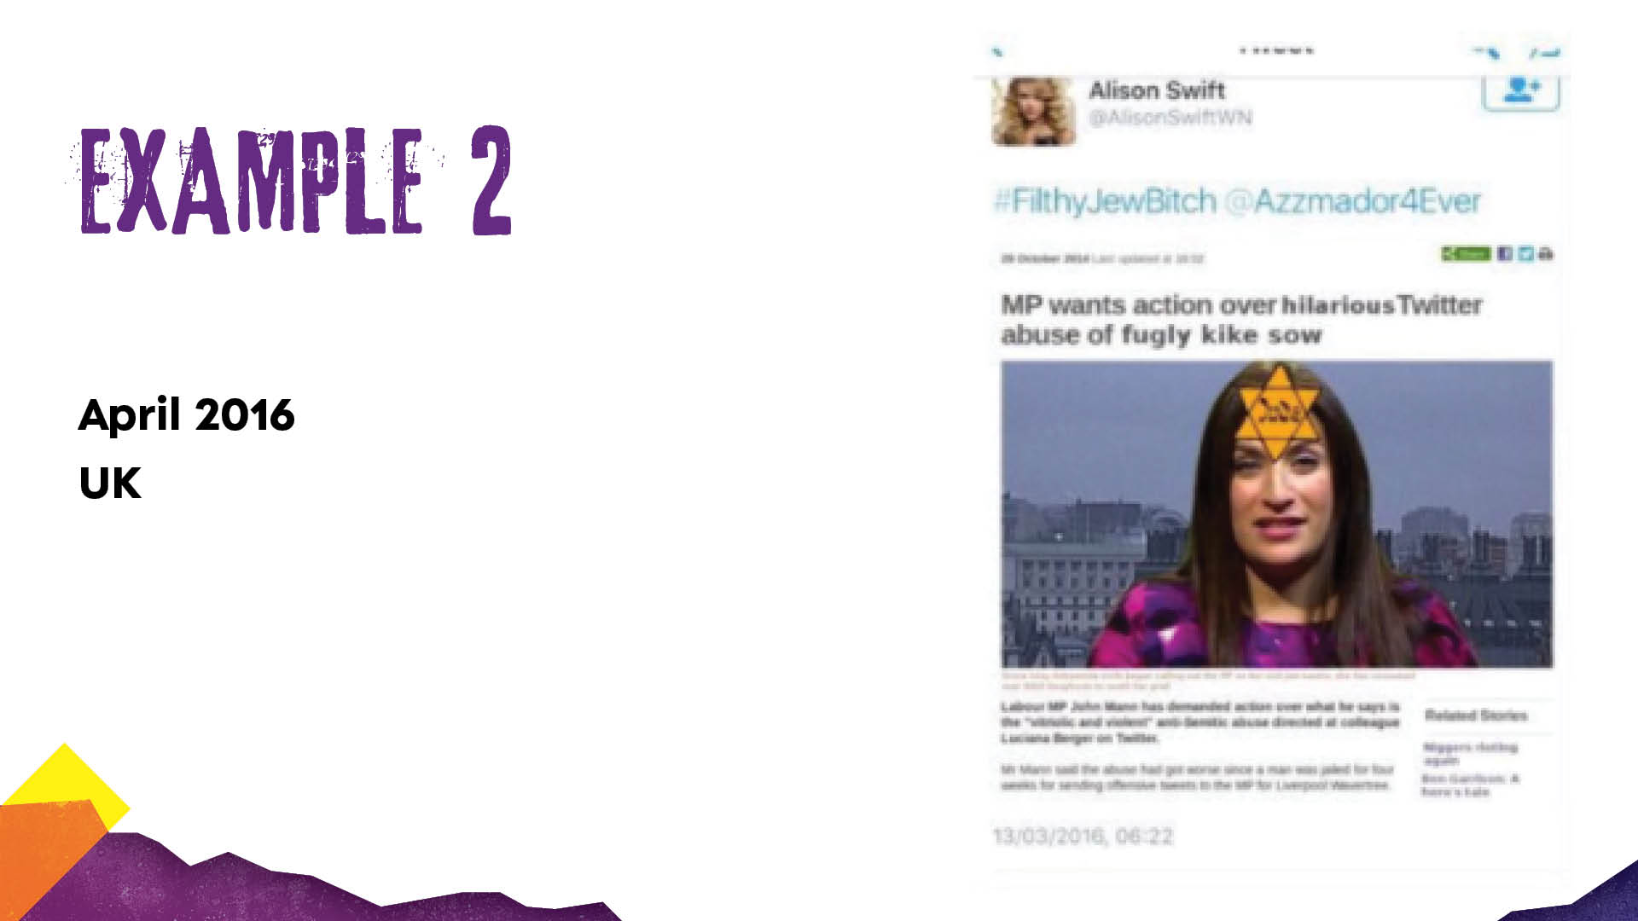
Notes:
Luciana Berger is Jewish and was an MP (member of parliament) 2010-2019
https://publications.parliament.uk/pa/cm201617/cmselect/cmhaff/136/13606.htm

Slide 6
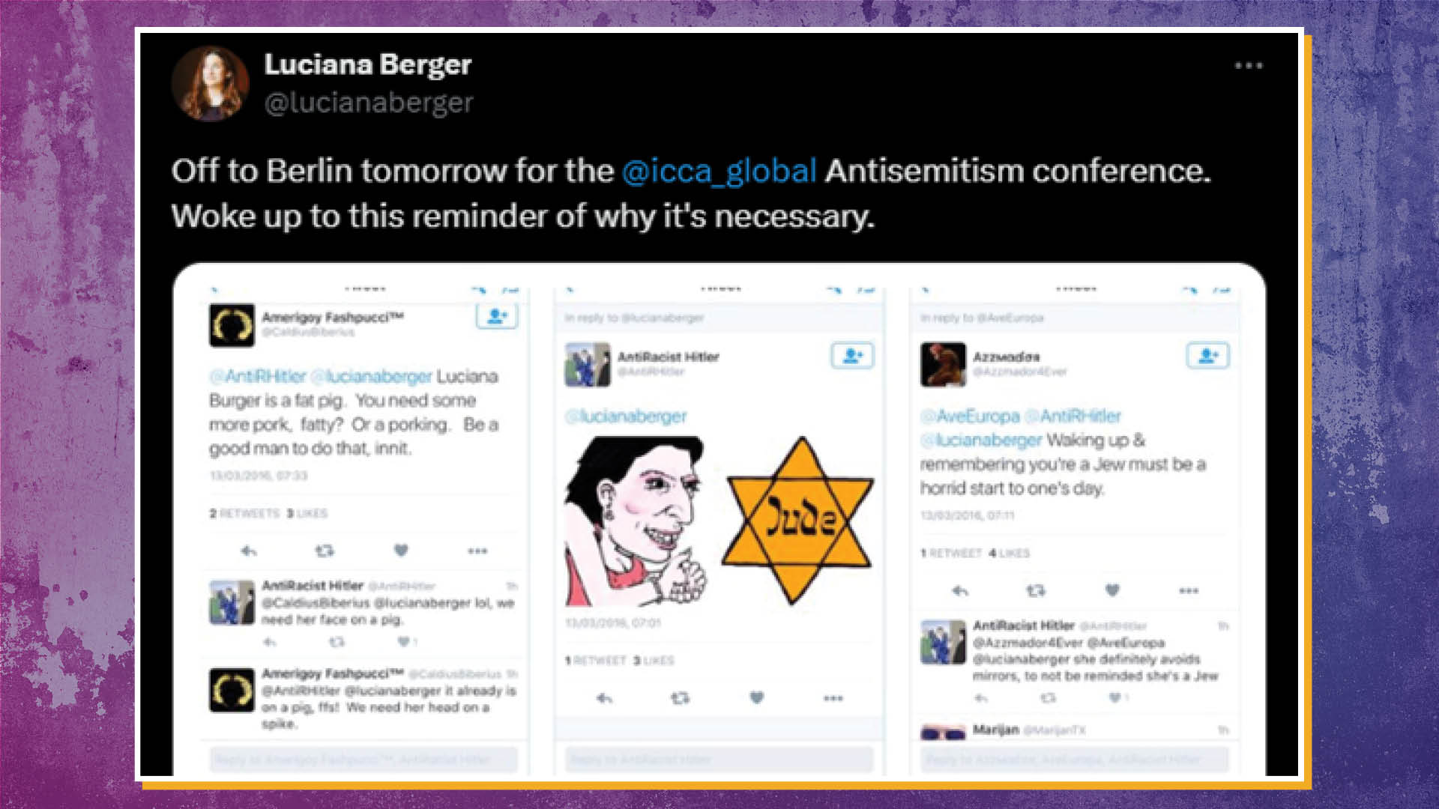
Notes:
Continuation from previous slide

Slide 7
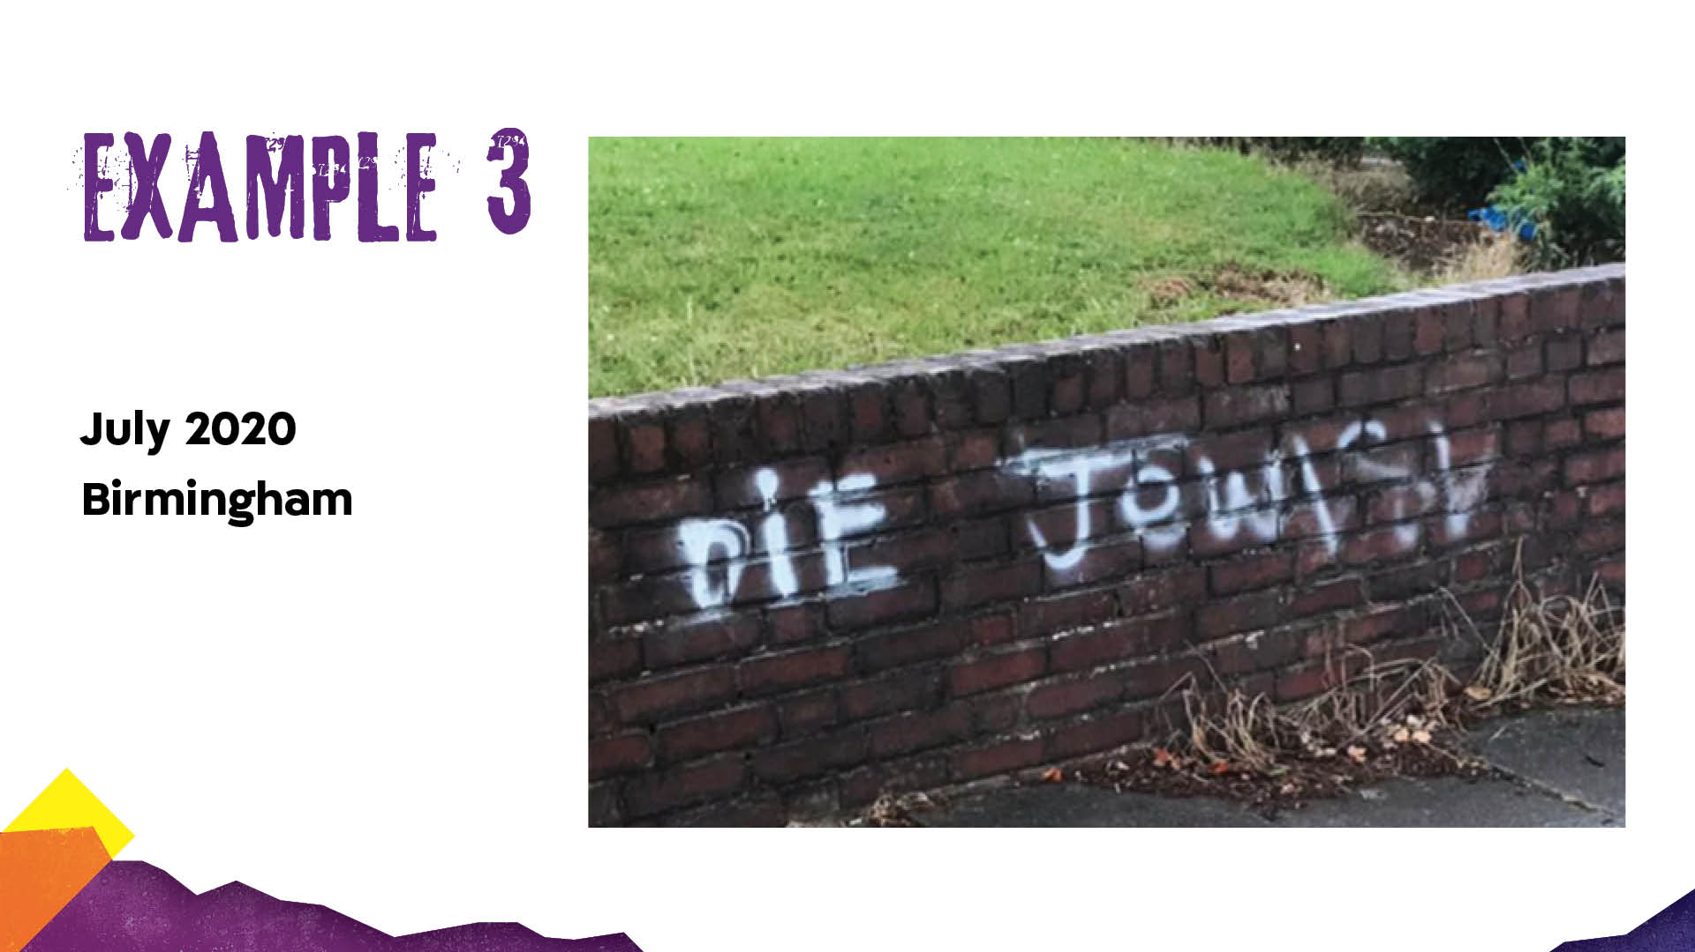
Notes:
July 2020 - Birmingham
https://combatantisemitism.org/cam-news/jewish-and-muslim-women-come-together-to-remove-anti-semitic-graffiti-in-uk/

Slide 8
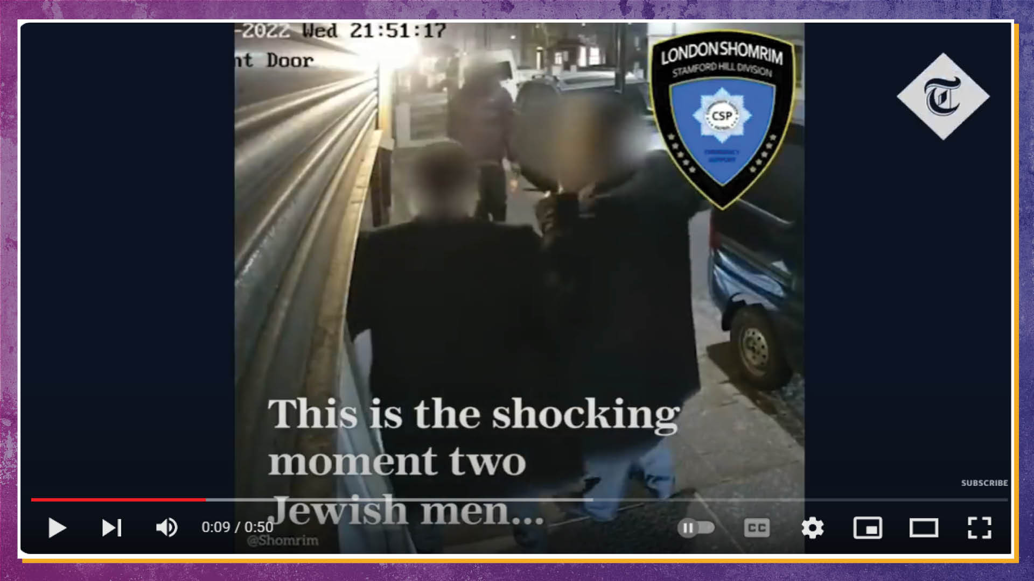
Notes:
EXAMPLE 5 - Haringey 2022
https://www.youtube.com/watch?v=luUMPkYKnSI

Slide 9


Notes:
TikTok antisemitism: Show from 5:35 – 7:10

Slide 10
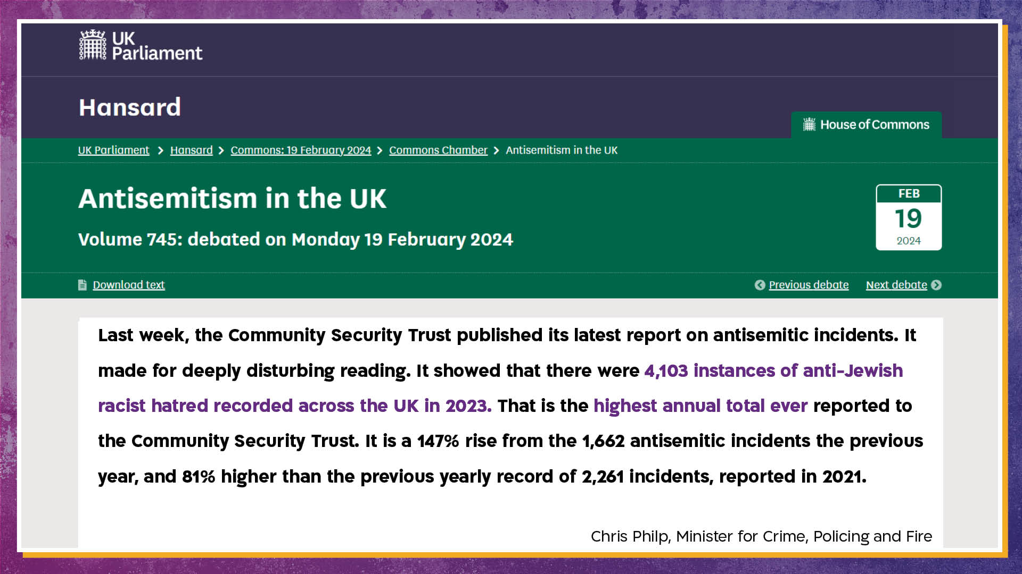
Notes:
https://hansard.parliament.uk/commons/2024-02-19/debates/788C5AA8-47E6-4D42-916C-E569D0B260A5/AntisemitismInTheUK

Slide 11
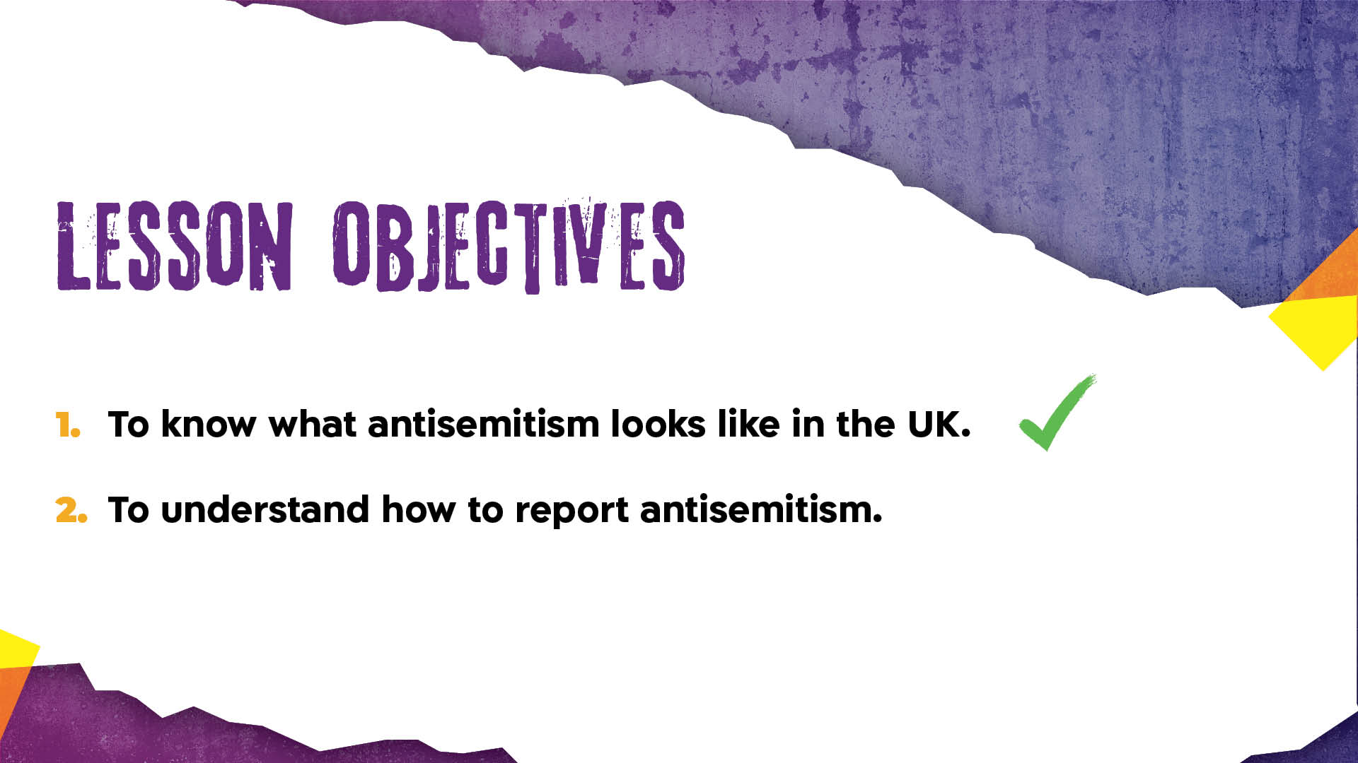

Slide 12
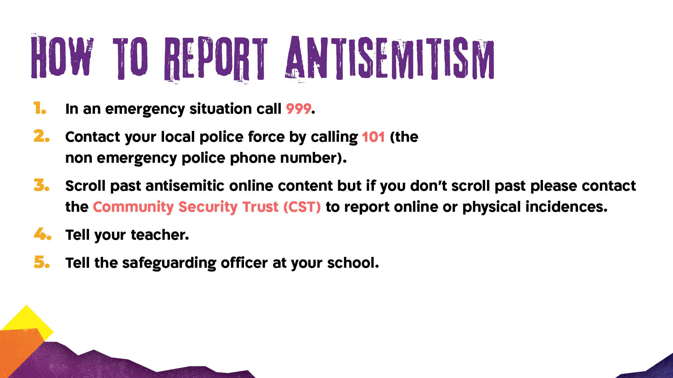
Notes:
The reason for scrolling past online antisemitic content is because the algorithm will then show you similar material because the algorithm will think this is something you are interested in. And if you comment on the post, it raises the profile of the post.

Slide 13


Slide 14
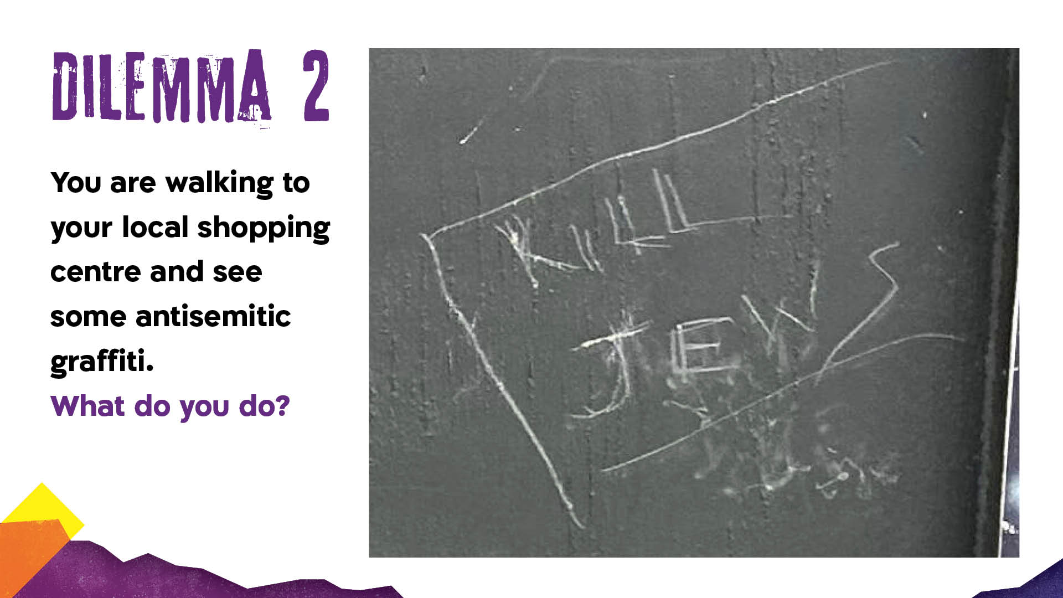
Notes:
Source for image: https://cst.org.uk/news/blog/2024/02/15/antisemitic-incidents-report-2023

Slide 15
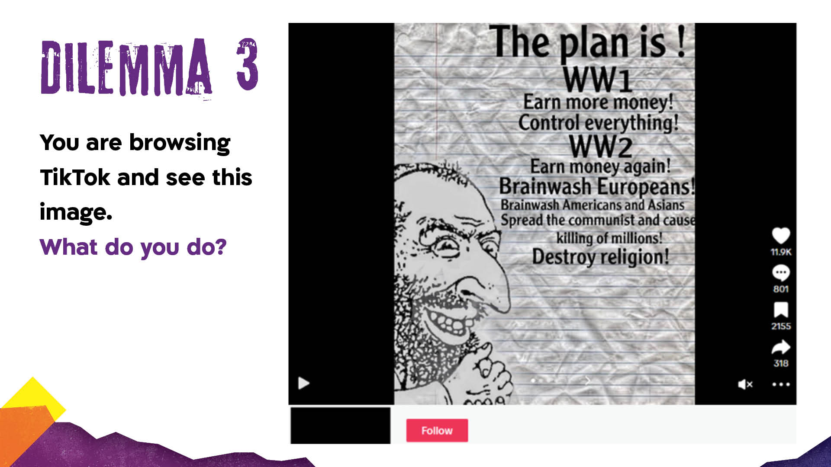
Notes:
This pre-World War 2 trope of Jews is being used in modern times.
https://www.adl.org/resources/blog/sliding-through-spreading-antisemitism-tiktok-exploiting-moderation-gaps

Slide 16
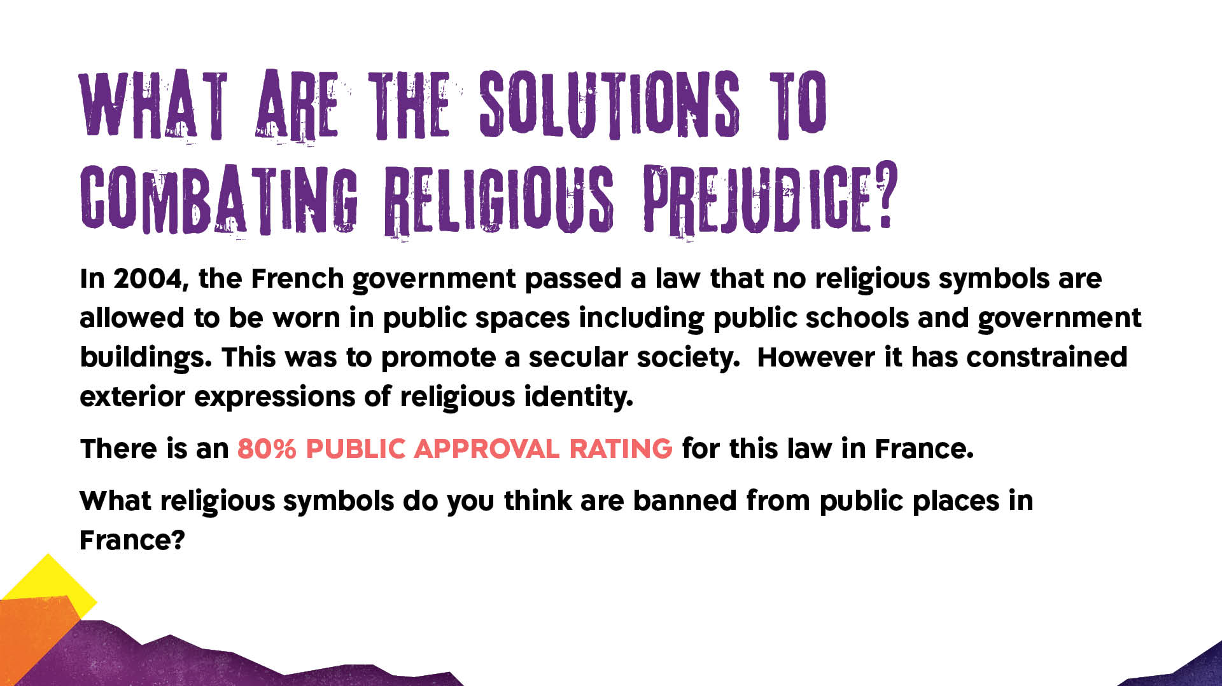
Notes:
Optional for higher ability. A) Crucifix, headscarf, Jewish skullcap, Star of David, sikh turbans etc.
Possible answer to the main question about solutions to combating religious prejudice is that religion is part of many people’s identity and cannot and should not be erased. The only way to combat any king of prejudice is through education and empathy.
https://bpr.studentorg.berkeley.edu/2023/11/15/frances-ban-on-religious-symbols-violates-free-expression/#:~:text=This%20restriction%20falls%20under%20France's,Christian%20crosses%20in%20public%20schools.

Slide 17
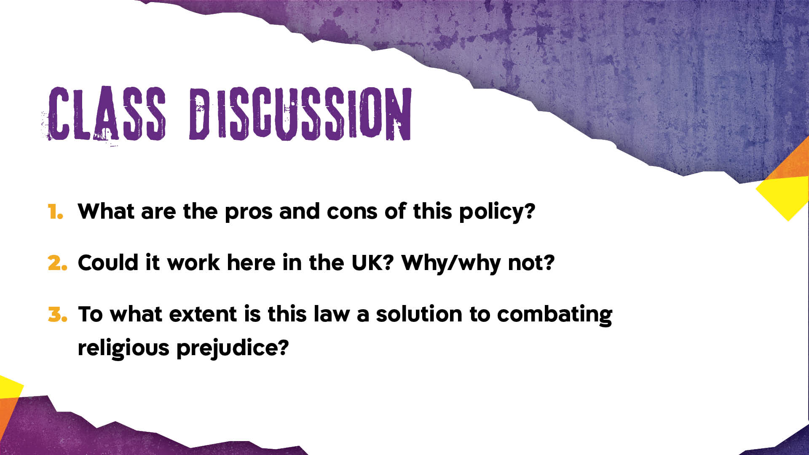
Notes:
Advanced discussion option. According to France’s Human Rights Commission, “racism and intolerance are rising in France” (2023) https://bpr.studentorg.berkeley.edu/2023/11/15/frances-ban-on-religious-symbols-violates-free-expression/#:~:text=This%20restriction%20falls%20under%20France's,Christian%20crosses%20in%20public%20schools.

Slide 18
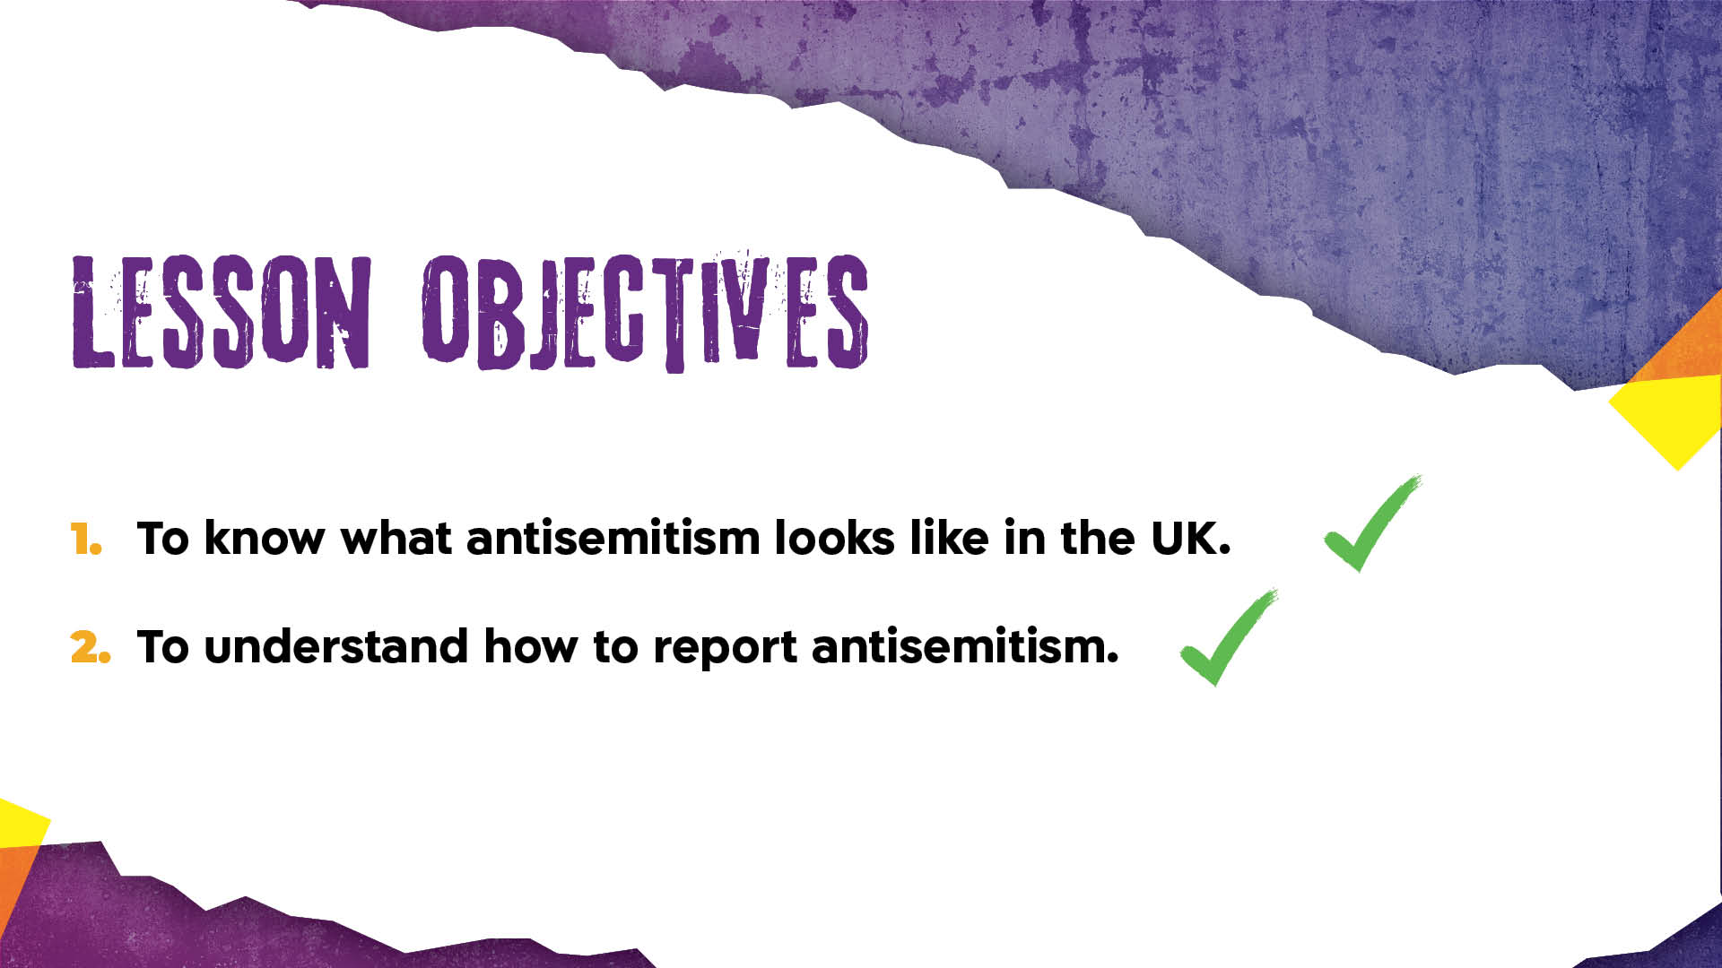
Notes:
Option 1: Please choose from this slide or the following slide as a plenary.

Slide 19
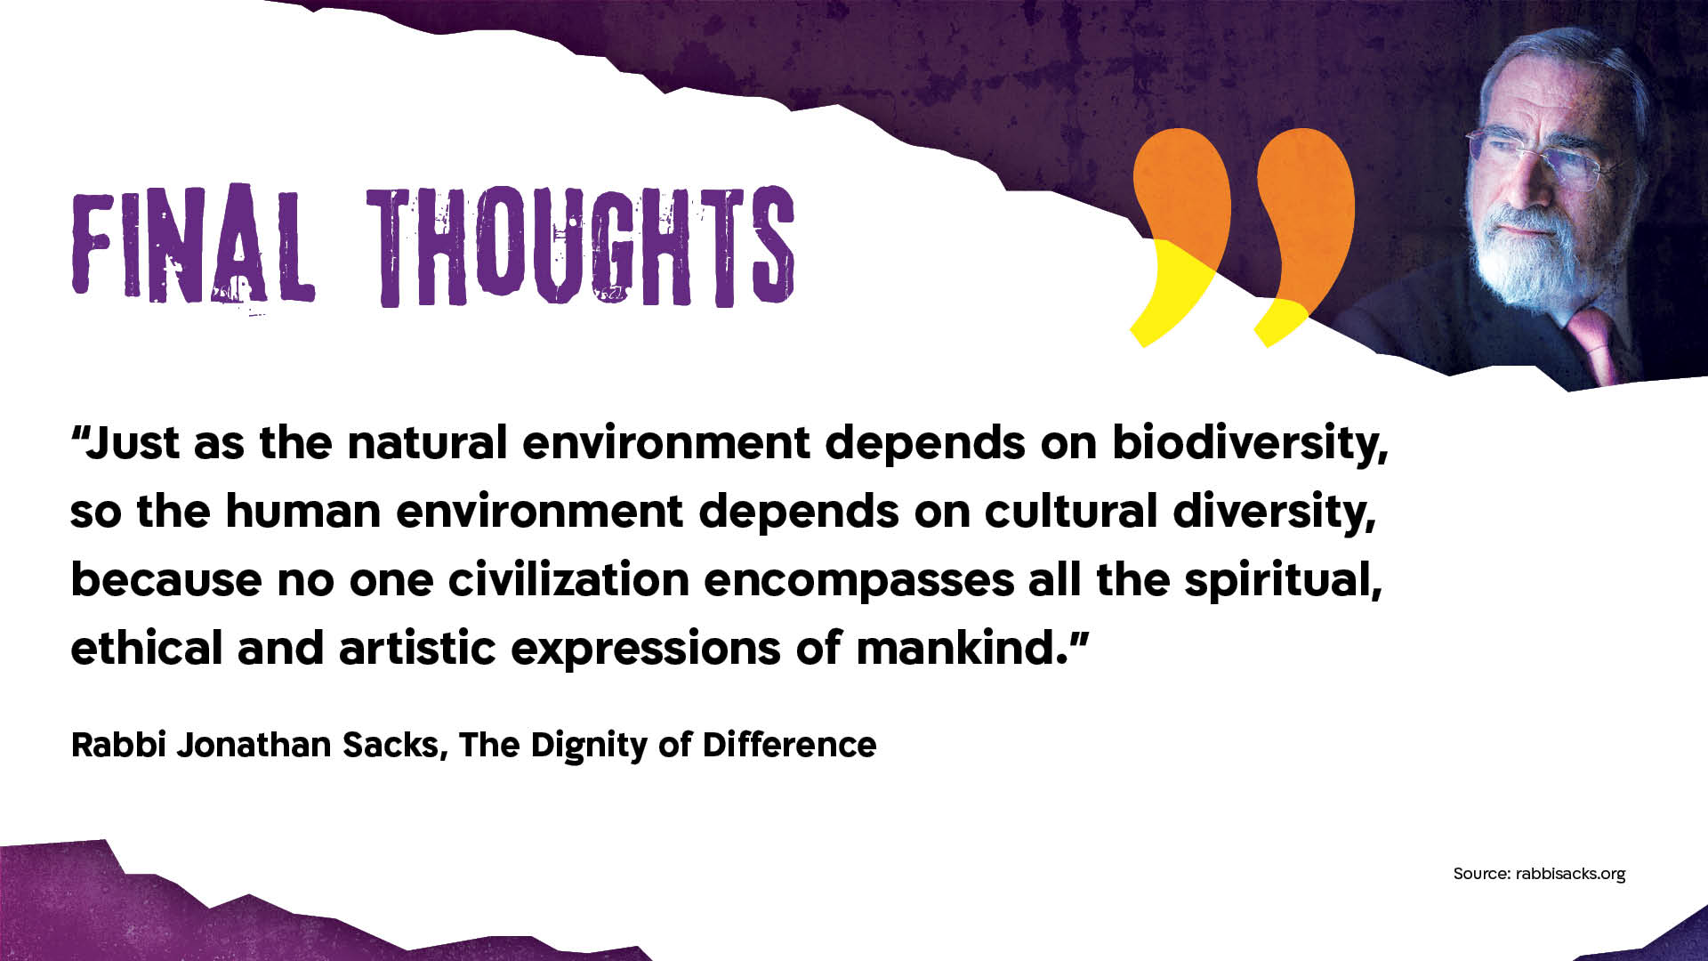
Notes:
Option 2

Slide 20
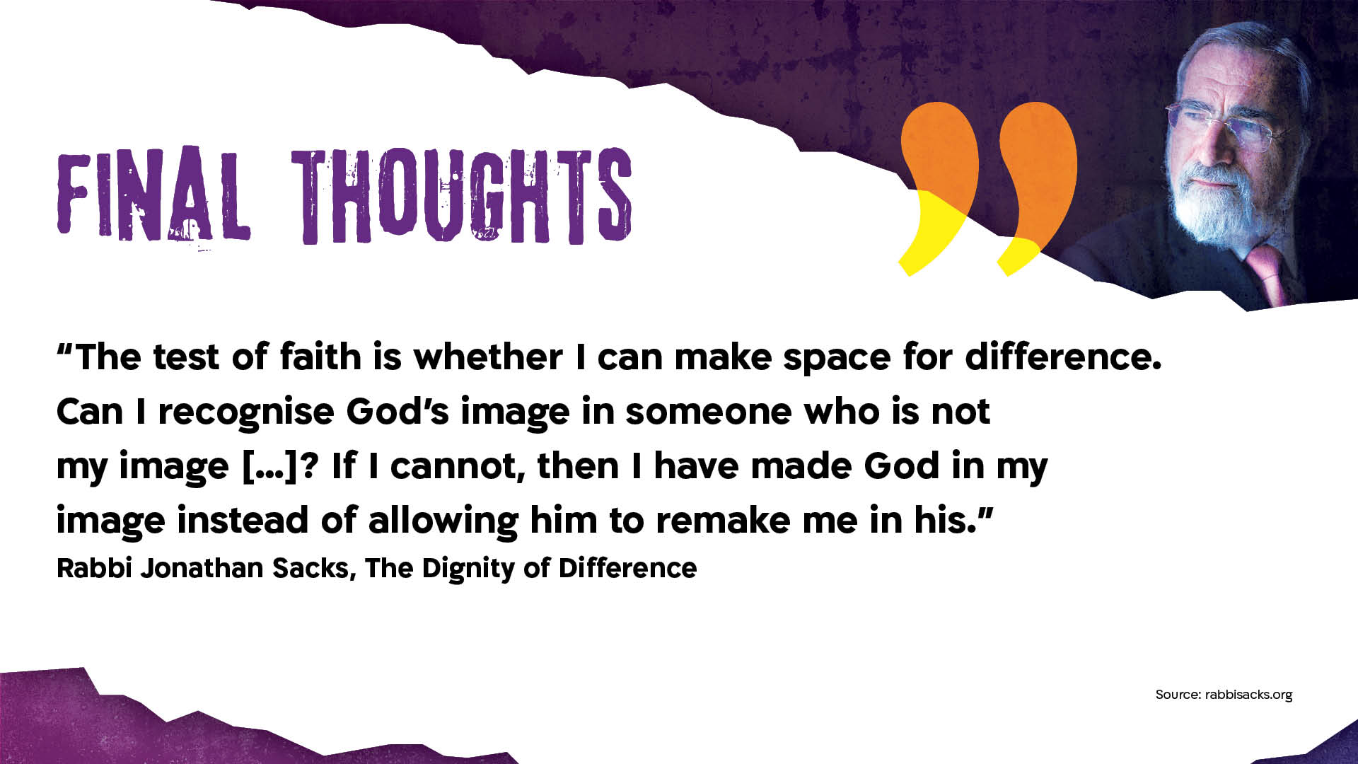

Slide 21
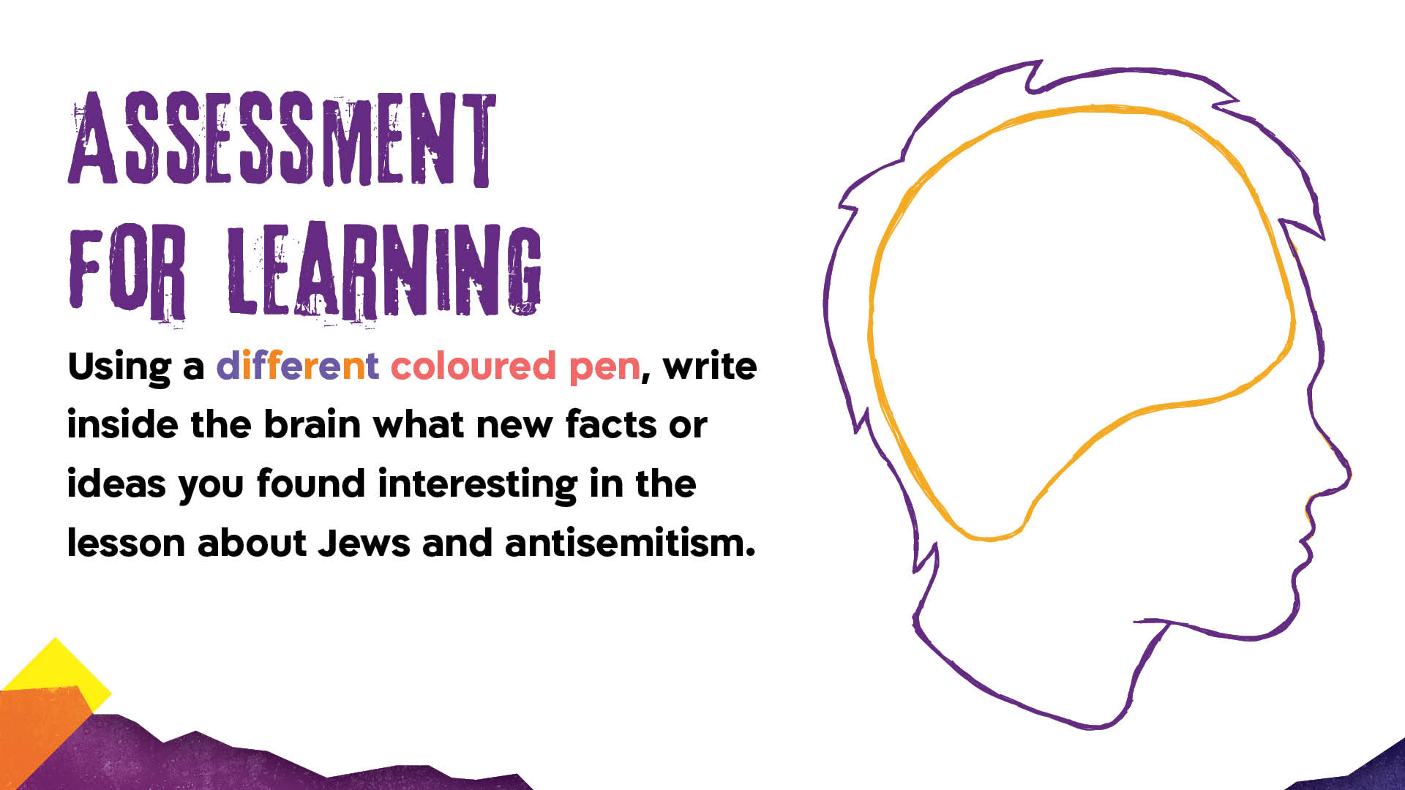

Slide 22


